Slide 1
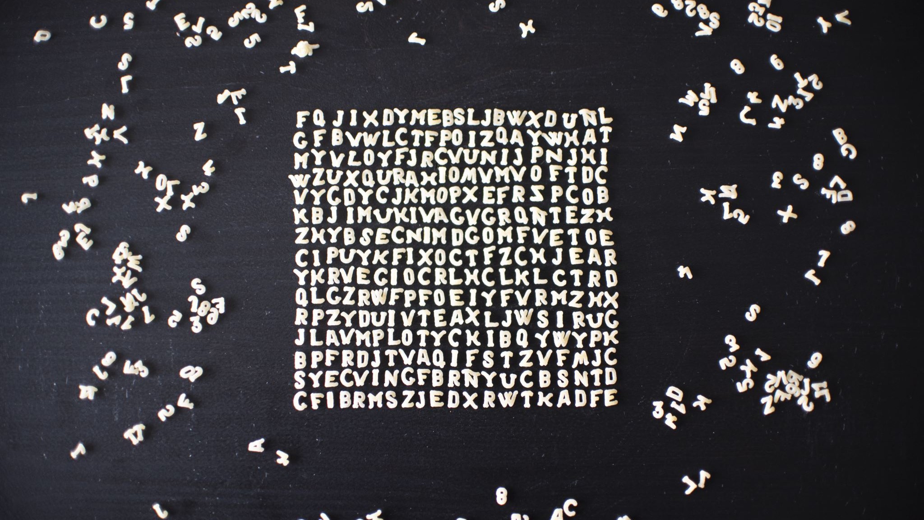
Caesars Cipher
Jonathon Moore
SWE-450
Professor Mark Reha

Slide 2

Project Overview
Message Encoding Algorithm
Runs on Intel DE10-Standard
Contains two custom FPGA Circuits
Cipher Circuit
BCD Decoder
Application Written in C
Uses slide switches as inputs
Second embedded systems project

Slide 3
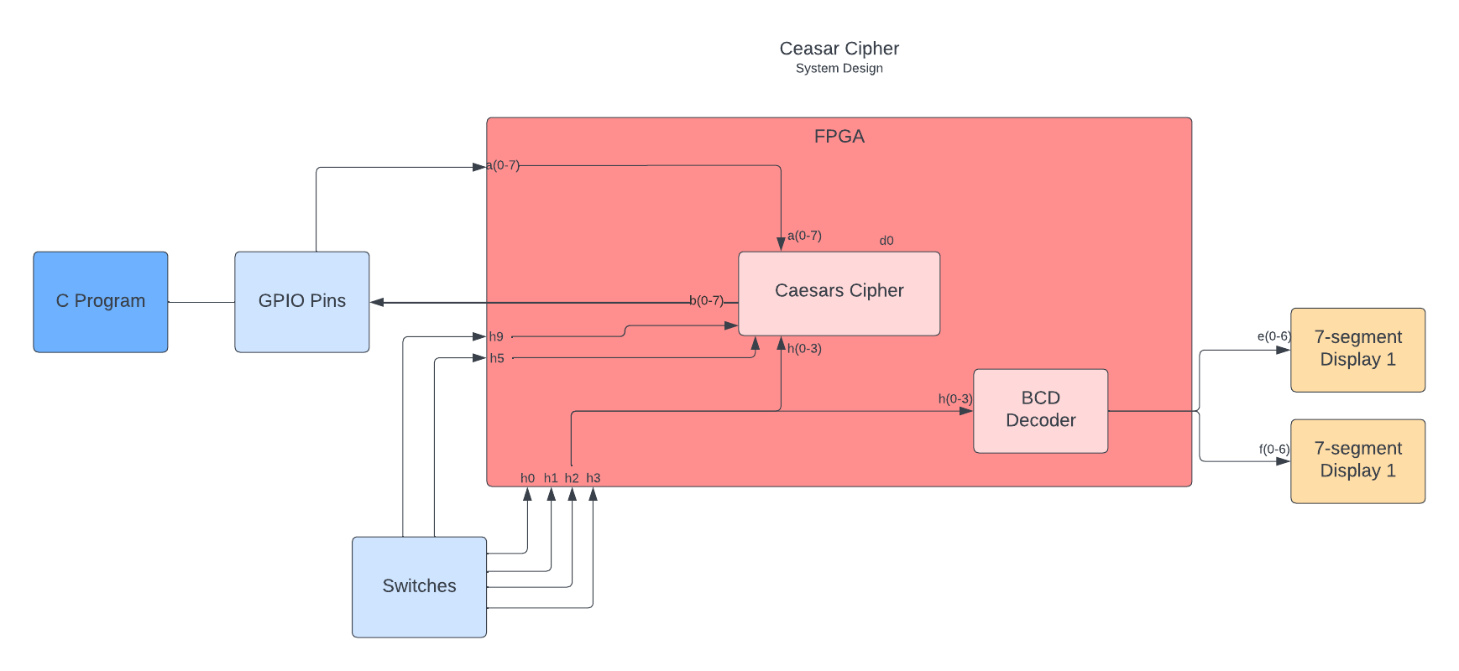
System Design

Slide 4
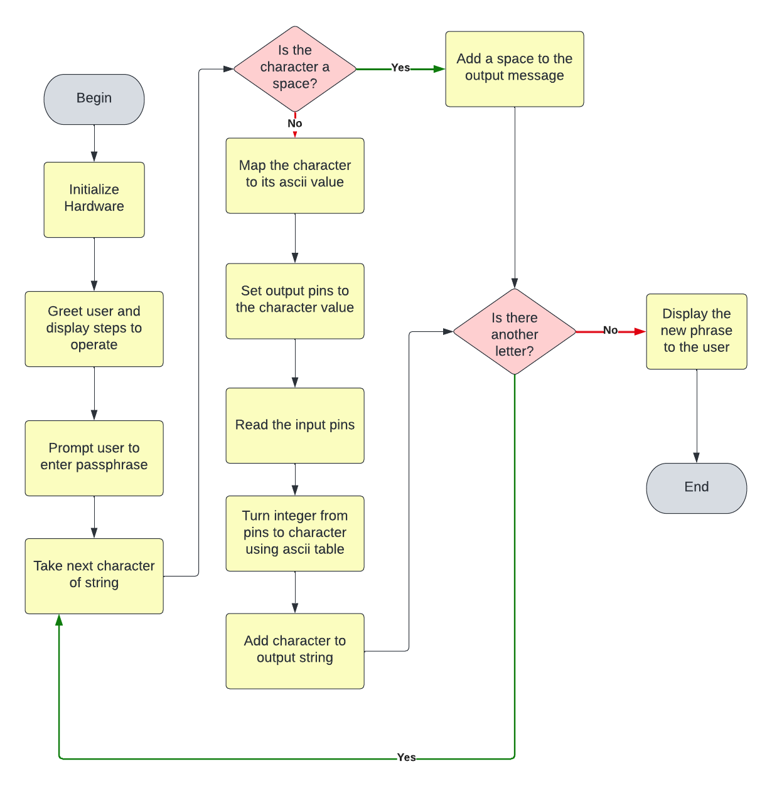
Application Design
Bridge between user and hardware
User sets the key and whether to encode/decode
User enters a message and receives output message
“Black box” design

Slide 5
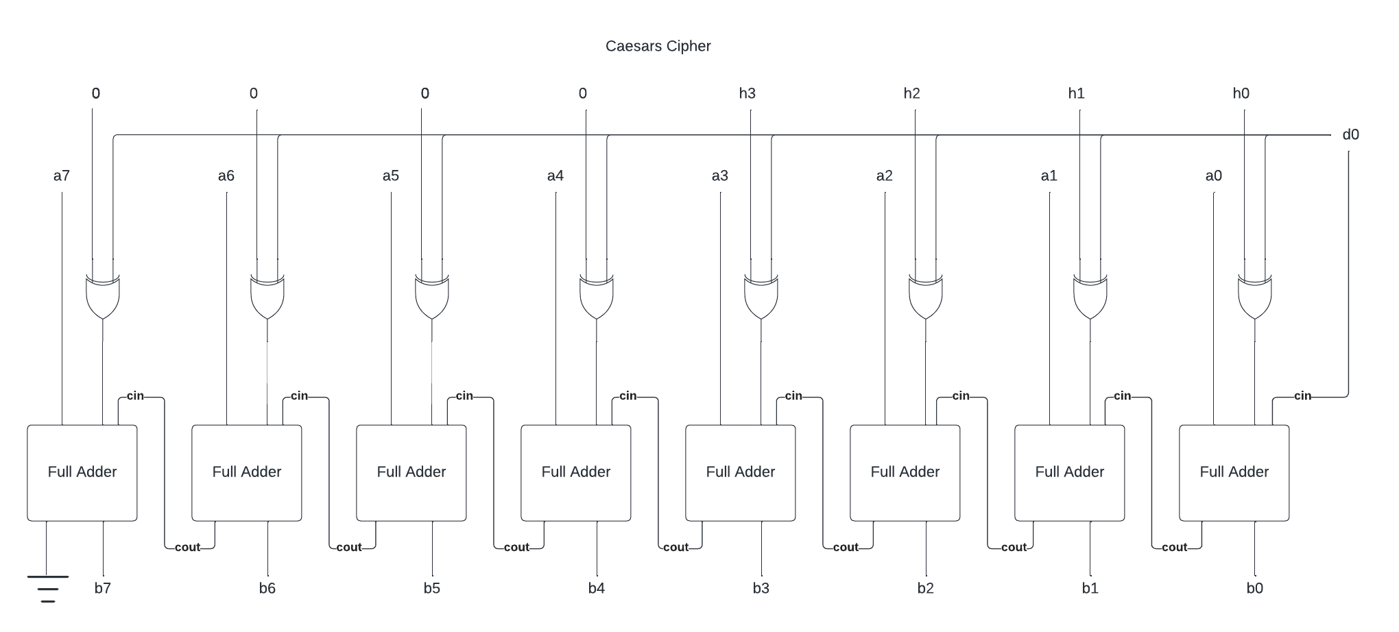
VLSI Design

Slide 6
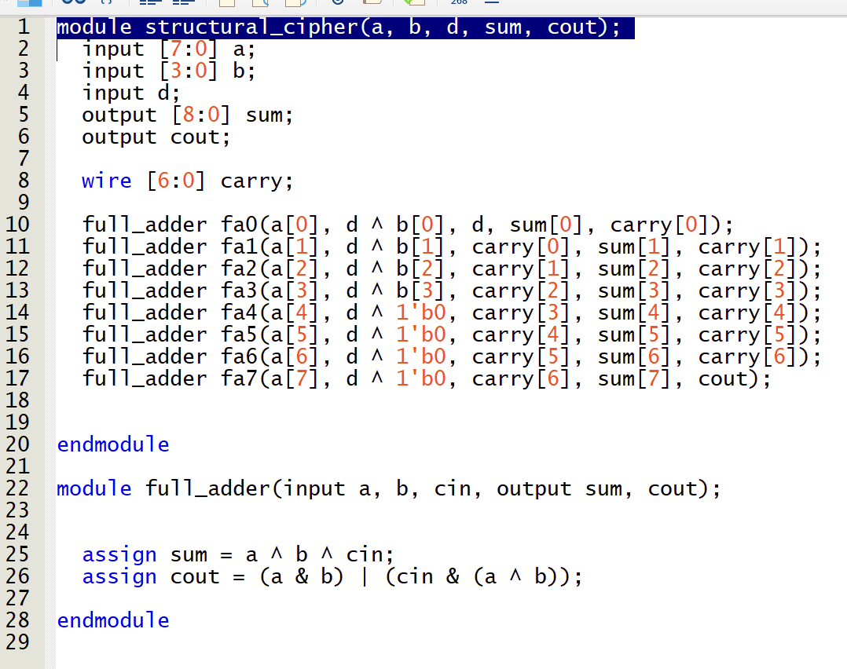
Structural - Verilog

Slide 7
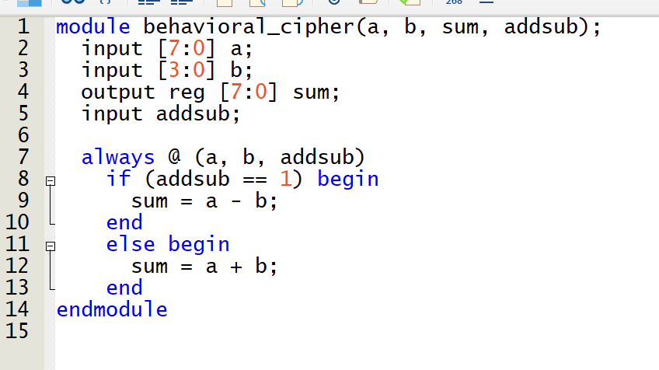
Behavioral - Verilog

Slide 8

Demonstration / Issues
Accessing the GPIO Pins
Tri-state
Bit Structures
Moving from binary array to passing integers
Technical Presentation: https://youtu.be/7QmjAOieums

Slide 9
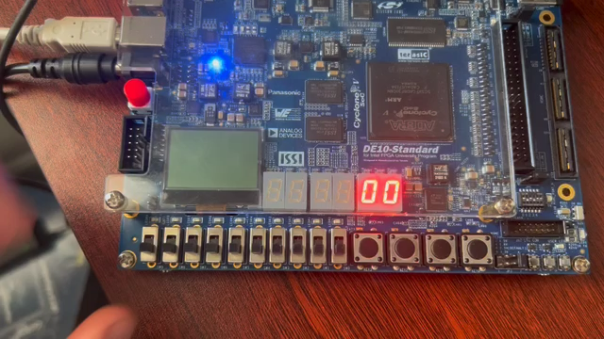

Slide 10
Thank you

